Slide 1







Southwest Airlines’ Nonstop Culture: Flying High Transparency and Empowerment

Slide 2

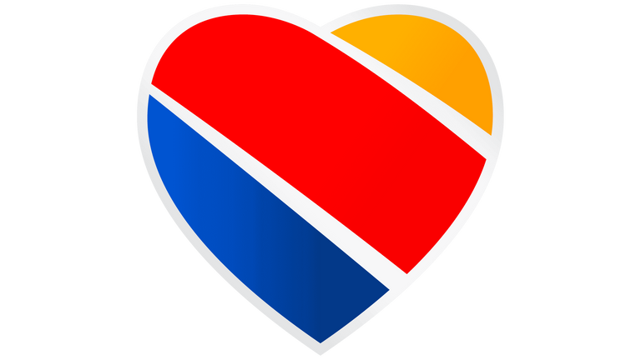
Problem Statement
If Southwest doesn’t address current market trends, there is opportunity for them to lose their competitive edge in the airline industry.

Slide 3


Market Trends
Increase in automation
Competitors imitating culture
Increase in demand due to globalization
Notes:
competitors imitate: social media
Automation (how would this impact SW culture)
competitors imitating culture
future demand increase (globalization= increase travel and flights) so need not to lose training and development which impacts culture

Slide 4
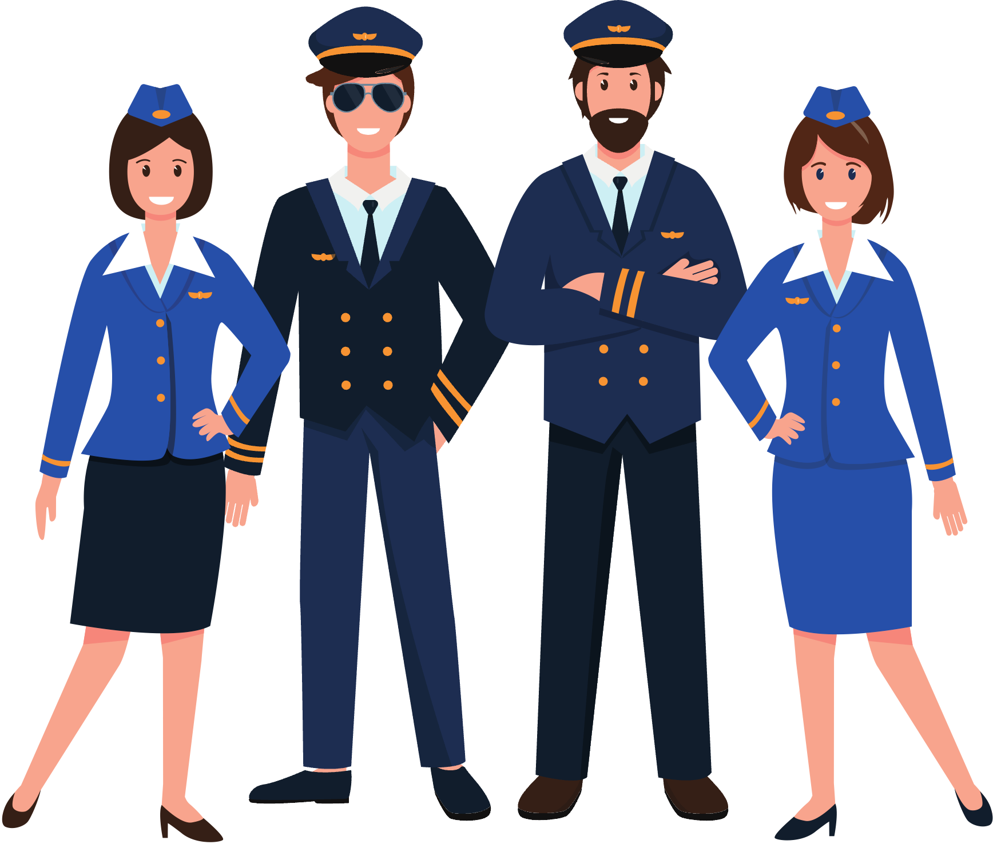
Competitive Edge
Southwest's distinctive culture sets it apart in the airline industry
Protecting this culture is paramount for maintaining employee loyalty, positive brand perception, and long-term success
Notes:
Southwest's distinctive culture stands as a unique and enduring competitive advantage, setting the airline apart in the dynamic landscape of the airline industry. It's not just about being a low-cost carrier anymore; it's about cultivating a culture that resonates and distinguishes Southwest from its competitors. While the low cost was historically a factor, it's important to recognize that Southwest's competitive edge extends beyond being the lowest-cost airline, as the industry landscape has evolved.
Protecting and nurturing this culture is paramount for Southwest. It goes beyond mere operations; it's about maintaining employee loyalty, fostering a positive brand perception, and securing the foundation for long-term success. In an industry where change is constant, the preservation of Southwest's unique culture is key to sustaining its position and thriving in the future.

Slide 5

Evaluation of Solutions
Change the Culture
vs.
Keep the Culture

Slide 6

Change the Culture
Pros:
Cons:
Lowers Costs
Might improve efficiency
Lose their differentiator
Changes the customer experience
Loss in the market share
Reduction in returning customers

Slide 7


Keep the Culture
Pros:
Cons:
Leadership Development
Talent attraction and retention
Creating an ethical organization culture
Increased productivity
Overcome barriers to acquisition, change, institutionalization
Could lose competitive edge
Higher Costs
Will continue to face struggles with the union

Slide 8
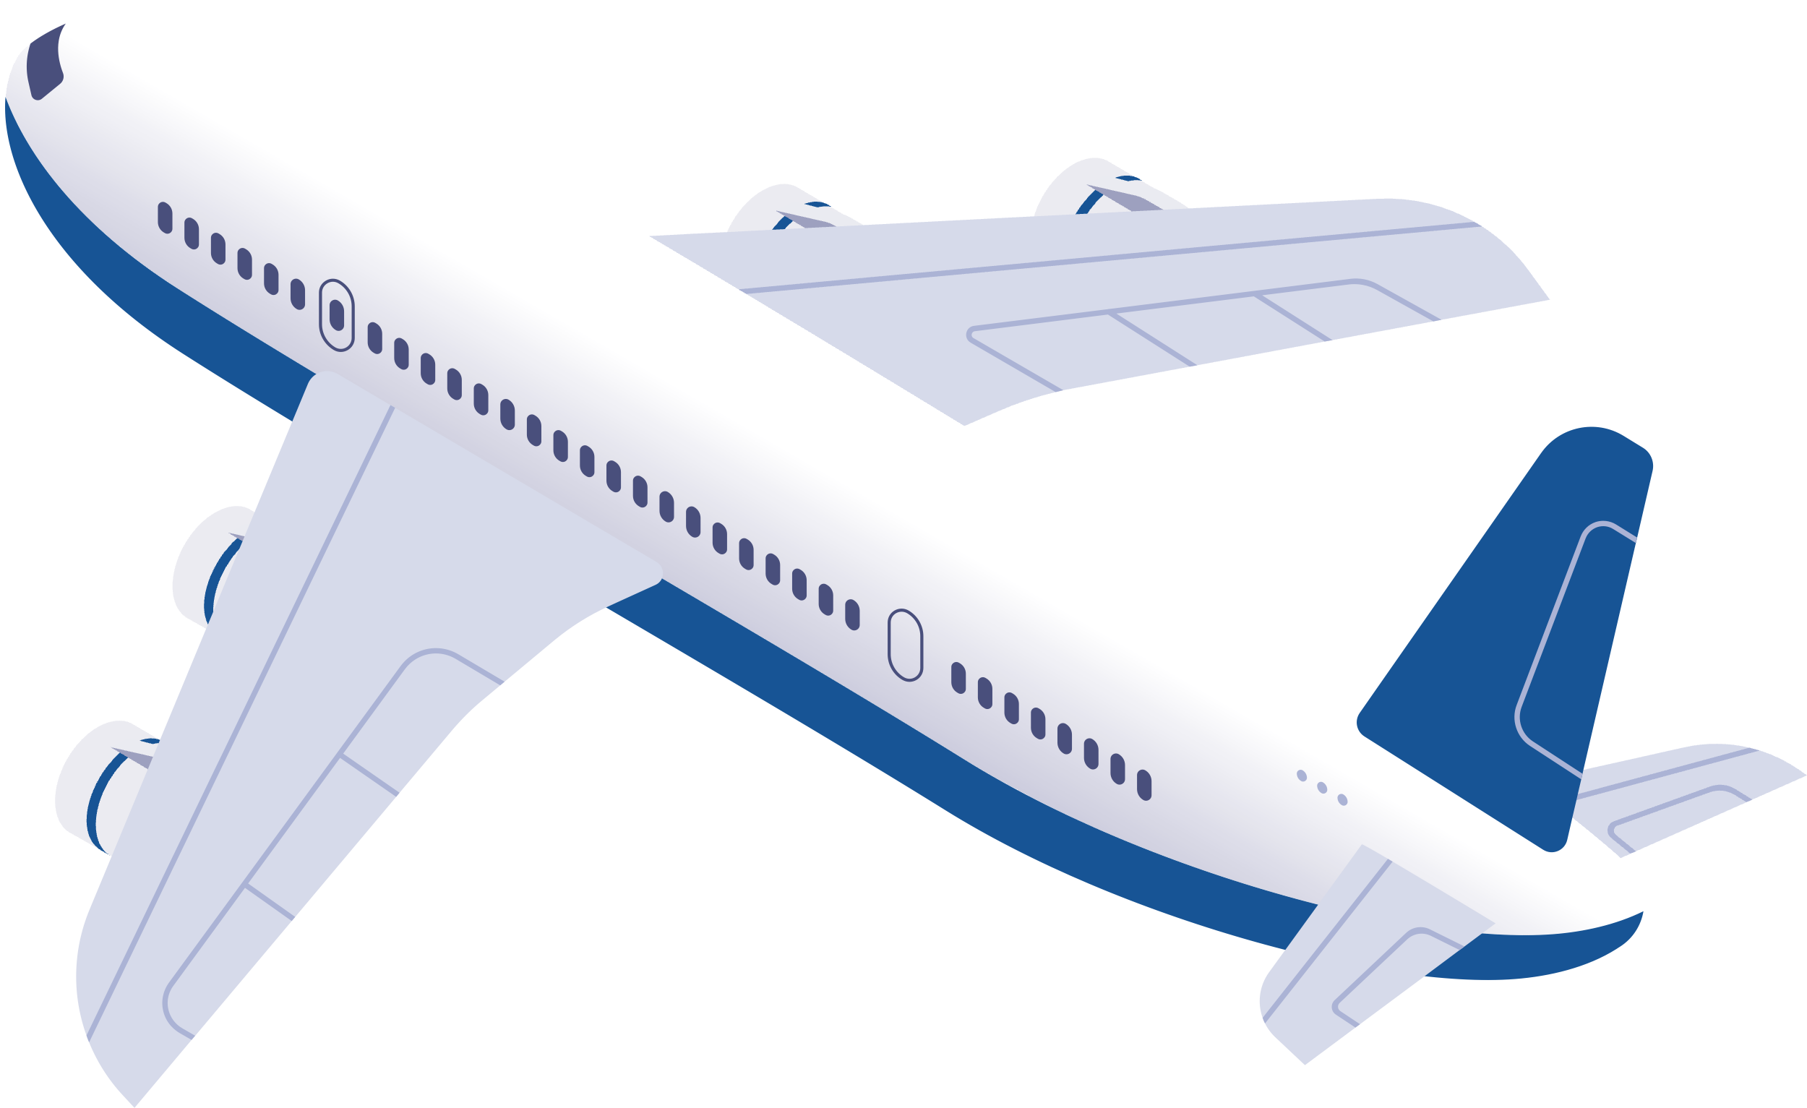

Recommended Actions
Maintain Training and Development
Balance Automation and Interaction
Hiring personality and training skills
Customer facing roles versus behind the scenes work
Continue to Push the Boundary
Don’t let up, keep making improvements
Notes:
Can't do anything about competitors imitating culture, but anyone who has had crab knows that the real thing is always better than imitation. SW can strengthen their culture by maintaining their training and development strategies, balancing automation and interaction, and continuing to push the boundary.
T+D:
- Hiring process at SW focused on strong relational competencies along with necessary skills foundation to succeed at job requirements. Wanted to hire personality and attitudes, train and develop skills later, because fun and energetic staff are what drew repeat customers.
A+I:
- Use automation in T+D and in non-customer facing roles to improve processes behind the scenes while still prioritizing that interaction that leads to brand loyalty. This will help keep up with competitors integrating automation, while not losing what makes them special.
Boundary:
- SW has consistently been the company in the industry to do more and it needs to continue to do so. When you stop, that is when people catch up.

Slide 9
Southwest Airlines should:
Keep the Culture

Slide 10



Any Questions?
Feel free to ask us anything!

